Slide 1
Project Name
Music Recommendation
Based On Face Emotion
Recognition

Slide 2
Guided By :- Dr. Pankaj H. Zope
-:TEAM MEMBERS:-
1. Aditi Dinesh Patil
2. Pranav Rajendra Mahajan
3. Vipul Vinayak Patil
4. Yogesh Kailas Patil

Slide 3
Problem Definition Develop a system that presents a cross-platform music player, which recommends music based on the real-time mood of the user through a web camera using Machine Learning Algorithms
Problem Statement

Slide 4
This project emotion based music player is helps the user to automatically play songs based on the facial emotions. Face emotion recognition is a technology that uses artificial intelligence to analyze facial expressions. It identify emotions such as happiness, sadness, anger, neutral and surprise. If the person has a negative emotion, then a certain playlist will be include related types of music And if the emotion is positive, then a certain playlist will be include related types of music
introduction

Slide 5
Detector is most effective only on frontal images of faces Sensitive to lighting conditions We might get multiple detections of the same face, due to overlapping sub-windows. Manual selection of songs. Randomly played/shuffled songs may not match the mood of the user.
Drawback of existing system

Slide 6
Extremely fast feature computation Efficient feature selection users don't want to select song manually. No need of playlist. Users don't want to classify the songs based on the emotions.
Expected Advantages of Proposed System

Slide 7
1. Support vector machine Support vector machines are a set of supervised learning methods used for classification, regression and outliers detection. SVMs can be used for text classification, image classification, spam detection, handwriting identification, and face detection, 2. Viola jones algoritms Viola-Jones was designed for frontal faces, so it is able to detect frontal the best rather than faces looking sideways, upwards or downwards. 3. Convolution neural network convolutional neural be used for face recognition, verification and clustering The face detection is done using CNN The captured image is input to CNN which learns features directly. And analyse the current emotion of the user
Algorithms

Slide 8
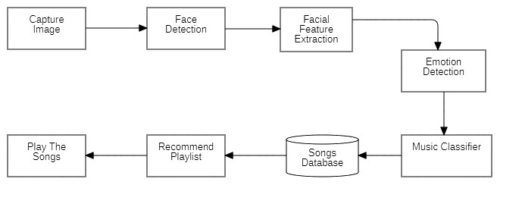
System architecture

Slide 9
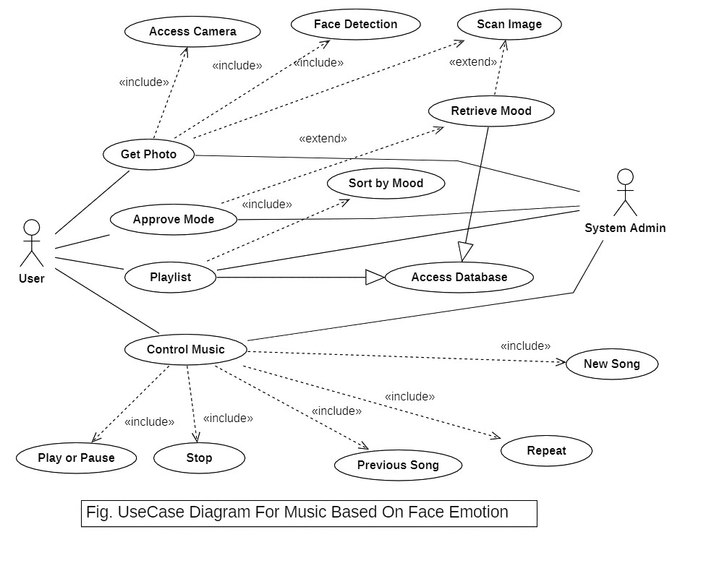

Slide 10
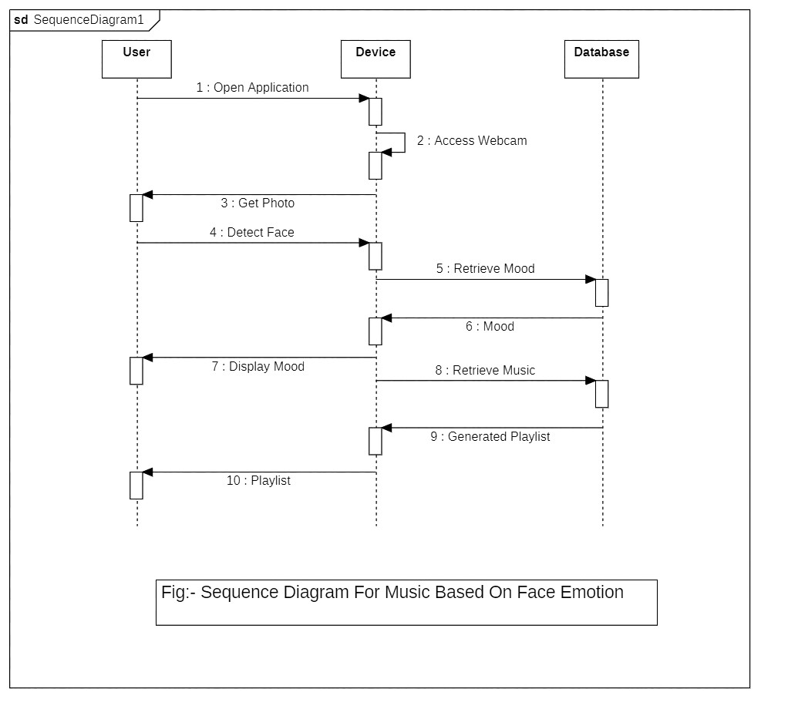

Slide 11
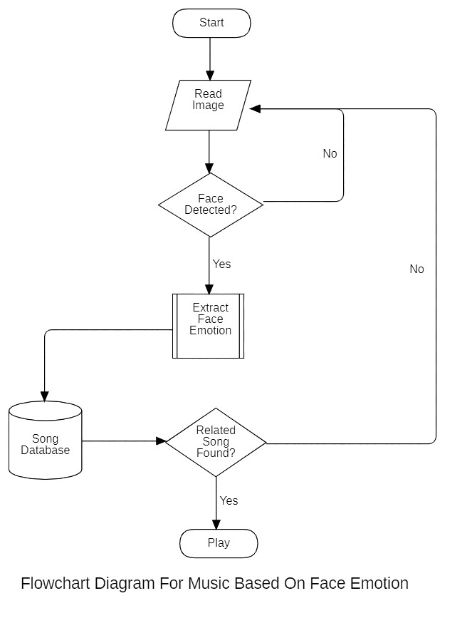

Slide 12
SOFTWARE REQUIREMENTS OS: Windows 7 and above /UBUNTU Programming Language: Python Software: PyCharm IDE HARDWARE REQUIREMENTS RAM: 8 GB Or Above Internal Storage: 8 GB Or Above
Technology Uses and Requirements

Slide 13
In this system, we provide an overview of how music can affect the user's mood and how to choose the right music tracks to improve the user's moods. After determining the user’s emotion, the proposed system provided the user with a playlist that contains music matches that detected the mood. music recommendation system based on facial emotion recognition will reduce the efforts of users in creating and managing playlist
Conclusion

Slide 14
1. "Music Emotion Recognition: A State of the Art Review" by Yi-Hsuan Yang, et al. (2014) - This paper provides of emotion recognition in music, including techniques for recognizing emotional content in audio and lyrics. 2. "Deep Learning for Music Emotion Recognition: A Review" by Wenwu Wang, et al. (2019) - This covers the application of deep learning techniques in music emotion recognition, which is a fundamental component of emotion-based music suggest systems. 3. "Emotion-Based Music Recommendation: A Survey" by Zhao, Shuo, et al. (2019) - While it may not focus on facial emotion recognition, this survey provides into the broader field of emotion-based music recommendation, including the use of various emotion recognition modalities. 4. "Multimodal Music Emotion Recognition: A Survey" by Soleymani, Mohammad, et al. (2018) - This survey discusses the use of multiple modalities, including audio, lyrics, and visual cues, for music emotion recognition detect by facial expressions
Literature Survey

Slide 15
Thank You🙏🏻

